Slide 1
Sustainable Uist Presentation
Notes:
Past to Present; Present to Future.

Slide 2
Boring, but important
Sources: NRS Scotland website; links at the bottom of the slides.
Geography levels: Datazone whenever available, otherwise Council Area.
(Almost) everything is an estimate. The further data is from a census (itself an estimate), the greater the uncertainty.
Notes:
Not an invitation to “trust no one” as rigorous QA in place, but rather to emphasise that population statistics is a reflection of life which is, of course, highly uncertain.
Rolling forward method of estimating population 2001-2010, which is then revised based on 2011 census. Next one in 2021.

Slide 3
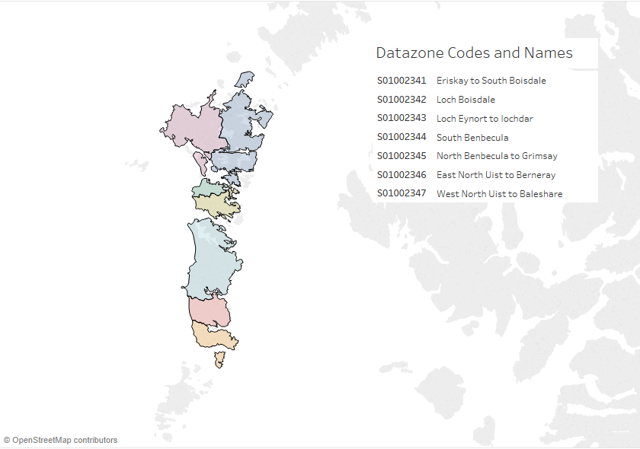
Data zones for Uist
Notes:
2001 and 2011 names will differ.

Slide 4
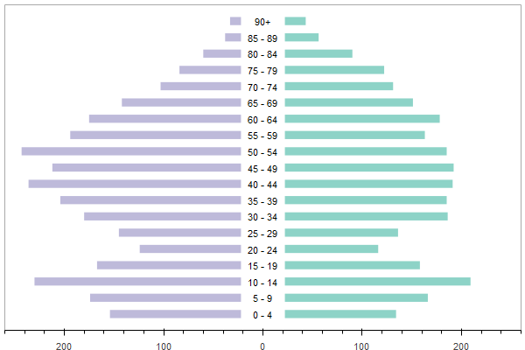
Back in 2001...
Uist population structure:
Key Statistics:
Total population count:
4854
Average Household Size: 2.32*
Life expectancy:
M: 71.7|F:79.6*
*for the whole of Western Isles
Notes:
Sources: https://www.nrscotland.gov.uk/statistics-and-data/statistics/statistics-by-theme/households/household-estimates/2017
Average household size for Scotland in 2001 was 2.27 so Western Isles people had bigger families than on average across Scotland.
https://www.nrscotland.gov.uk/statistics-and-data/statistics/statistics-by-theme/life-expectancy/life-expectancy-in-scottish-areas/time-series-data

Slide 5
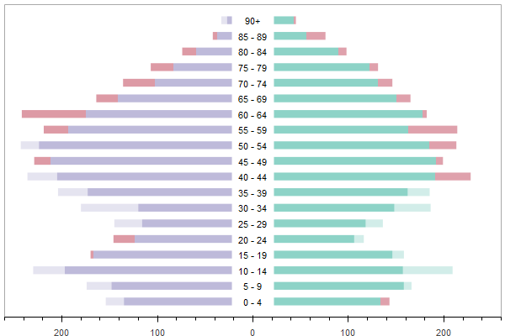
Fast Forward to 2009...
Uist population structure:
Key Statistics:
Total population count:
4873
Average Household Size: 2.22*
Life expectancy:
M: 73.9|F:82.3*
*for the whole of Western Isles
Notes:
Sources: https://www.nrscotland.gov.uk/statistics-and-data/statistics/statistics-by-theme/households/household-estimates/2017
Scotland average household size was 2.18 in 2009.

Slide 6
2001 – 2009 Scotland context
In 2001, Western Isles were the 13th Council Area in Scotland by average household size. By 2009 it dropped 2 places to 15.
In terms of population, Scotland as a whole grew by 3.3% and Uist datazones registered a much smaller increase of 0.3%.
Over the same period, the changes in Scotland’s population structure were similar, e.g. the 5-14 & 30-39 brackets declined, but with a crucial difference that there was an increase in the 20-29 bracket.
Notes:
For components of population change, I could only find 2001-2011 data:
https://www.nrscotland.gov.uk/statistics-and-data/statistics/statistics-by-theme/population/population-estimates/mid-year-population-estimates/mid-2002-to-mid-2010-revision/list-of-tables
Scotland population time series by single age and year is here:
https://www.nrscotland.gov.uk/statistics-and-data/statistics/statistics-by-theme/population/population-estimates/mid-year-population-estimates/population-estimates-time-series-data

Slide 7
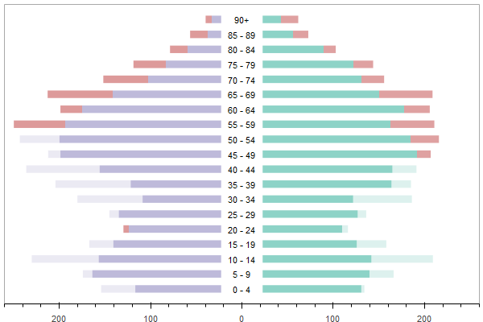
Fast-Fast Forward to 2016
Uist population structure:
Key Statistics:
Total population count:
4679
Average Household Size: 2.05*
Life expectancy:
M: 76.6|F:82.6*
*for the whole of Western Isles
Notes:
Sources: https://www.nrscotland.gov.uk/statistics-and-data/statistics/statistics-by-theme/households/household-estimates/2017
Scotland average household size was 2.17 in 2016 – barely changed from 2009.
Life expectancy: https://www.ons.gov.uk/peoplepopulationandcommunity/birthsdeathsandmarriages/lifeexpectancies/datasets/lifeexpectancyatbirthandatage65bylocalareasintheunitedkingdomtable2ukandlocalareasinscotland

Slide 8
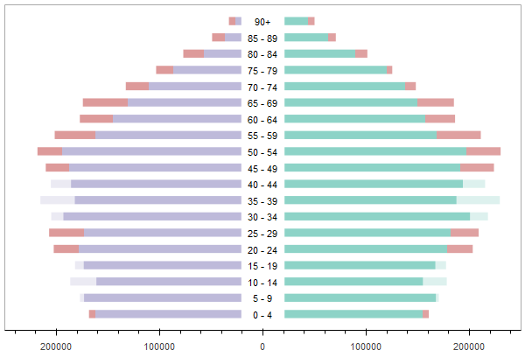
2001 – 2016 Scotland context
Scotland population structure change:
Scotland’s population grew by 6.7%, whereas Uist’s population declined by 3.6% over the same period.
However, growth isn’t evenly split across the country.
Notes:
Is the population growth coupled with ubranisation mean more remote areas like Uist are missing out?
Sources: https://www.nrscotland.gov.uk/statistics-and-data/statistics/statistics-by-theme/population/population-estimates/special-area-population-estimates/population-estimates-by-urban-rural-classification
https://www.gov.scot/Topics/Statistics/About/Methodology/UrbanRuralClassification
Stornoway: Very Remote Small Towns (Settlements of 3,000 and 9,999 people and with a drive time of over 60 minutes to a settlement of 10,000 or more.)

Slide 9
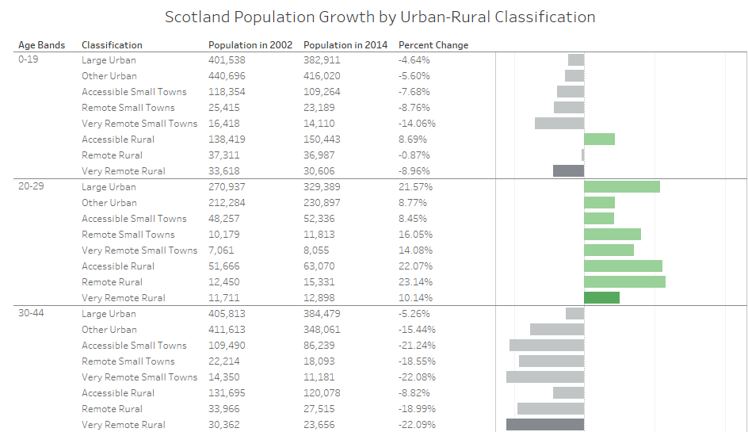
Notes:
Show the Tableau Workbook with Maps: Uist is classed as Very Remote Rural defined using population density (based on postcodes and census data) and drive time to the nearest settlement of 10,000 or more people.

Slide 10
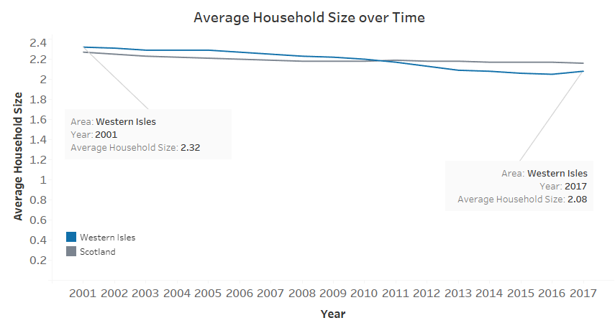
Average Household Sizes
Western Isles recorded the biggest drop in average household size from 2001 to 2017 among all 32 council areas in Scotland. It fell 10% whereas Scotland fell 5%

Slide 11
2016 basis for population projections
Uncertainty inherent in all projections
Comparable areas
Difficulty in projecting populations in uncertain times: Brexit
Components of population growth
Notes:
Factors like new housing developments or major employer closing down can force changes in population trends at a quicker rate than expected.

Slide 12
Uncertainty
Forecasting scenarios or variants
Compounding uncertainty over long (25+) periods
State of the population
Catastrophic events
Notes:
- If the scale of negative impacts is much greater than any possible enhancements resulting from an uncertain forecast, policy might be better directed towards avoiding the bad outcome, rather than being guided by a middle forecast.
Compounding uncertainty over time periods longer than a single generation (unknown (estimated) how many reproductive-age women there will be).
State of the population: is it moving along a known (previously experienced) path? Different patterns for uncertainty in fertility in countries at different points in demographic transition
Interesting discussion: https://www.nap.edu/read/9828/chapter/9#200

Slide 13
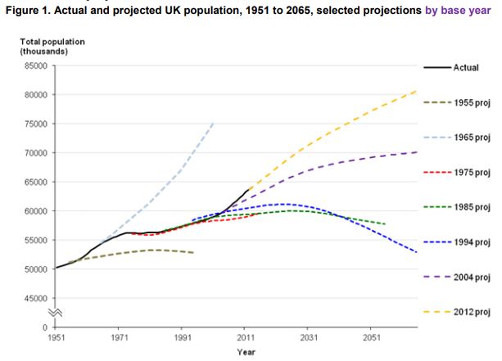
Total UK population
Notes:
Source: https://www.ons.gov.uk/peoplepopulationandcommunity/populationandmigration/populationprojections/methodologies/nationalpopulationprojectionsaccuracyreport
Main sources of projection errors: under-projection of migration and over-projection of deaths.

Slide 14
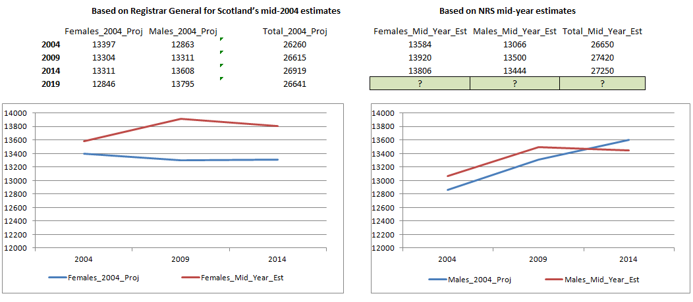
Closer to home – Western Isles projection
Notes:
Sources:
https://www.cne-siar.gov.uk/media/5597/ohmsstudy.pdf
https://www.nrscotland.gov.uk/statistics-and-data/statistics/statistics-by-theme/population/population-estimates/mid-year-population-estimates/population-estimates-time-series-data
https://www.nrscotland.gov.uk/files/statistics/population-estimates/04mype-cahb-booklet-revised.pdf

Slide 15
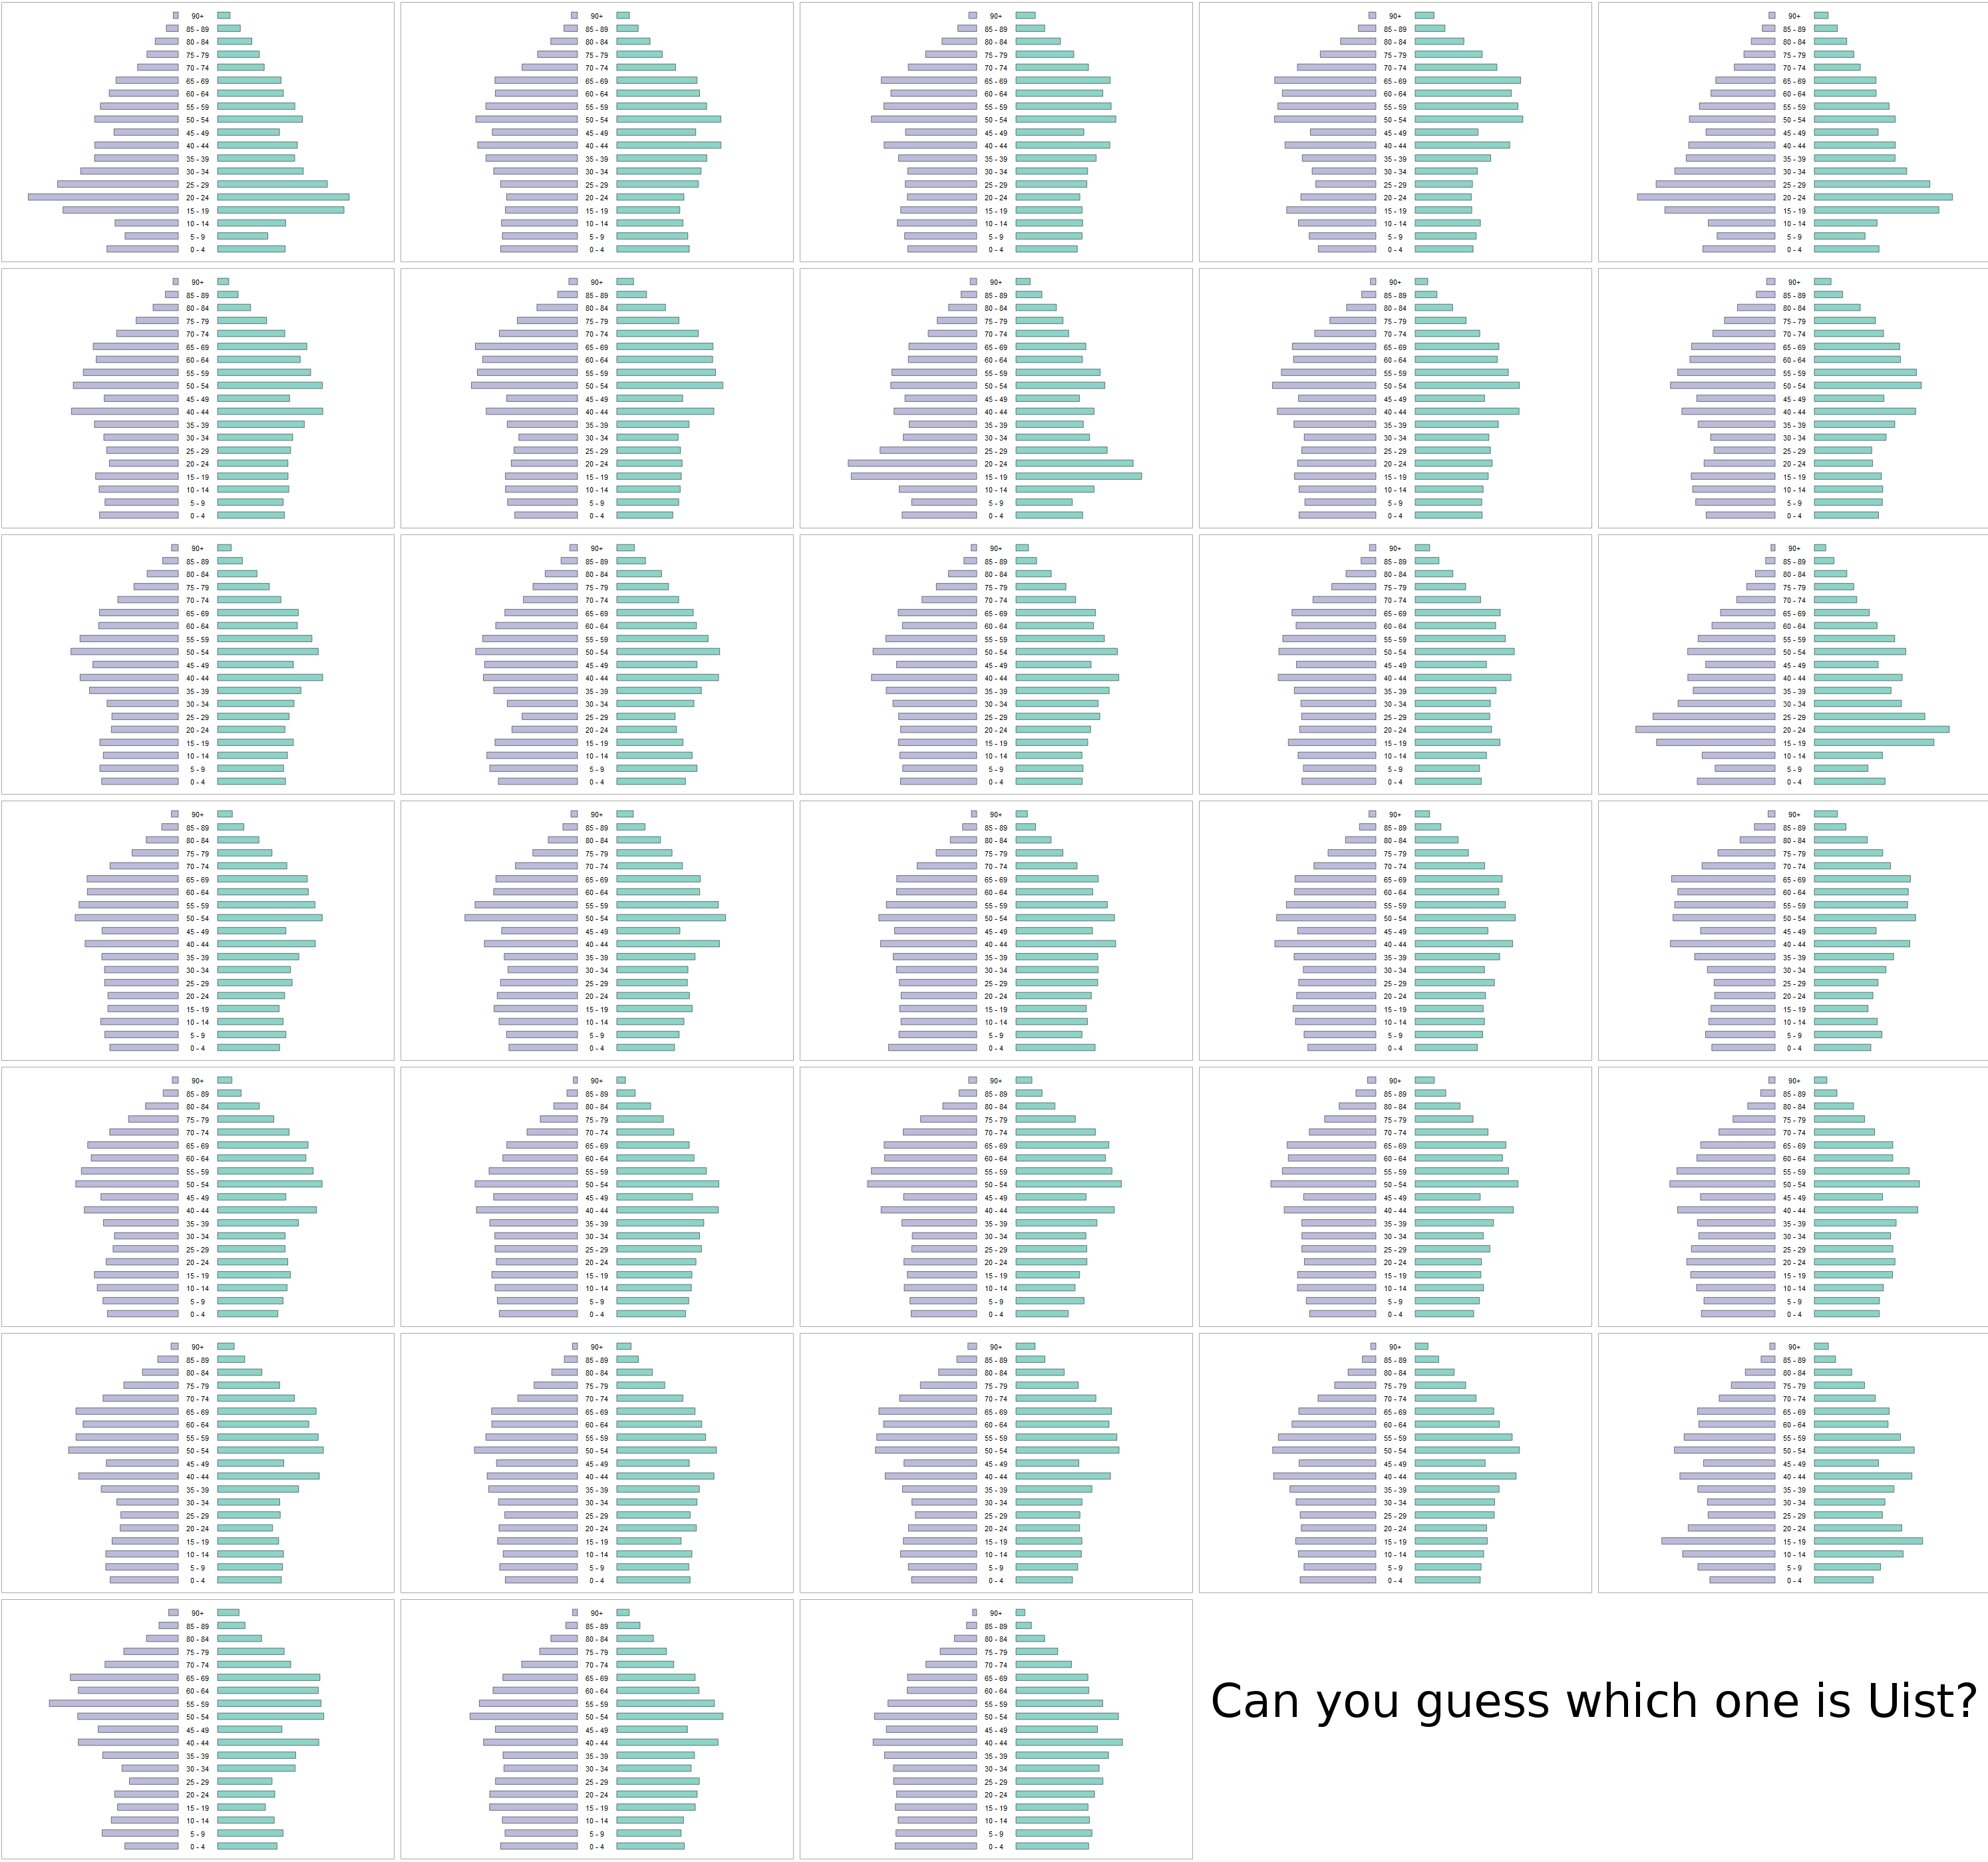

Slide 16
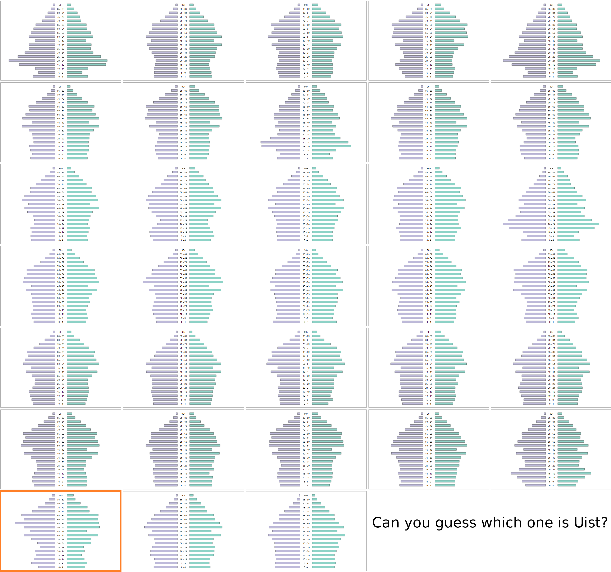

Slide 17
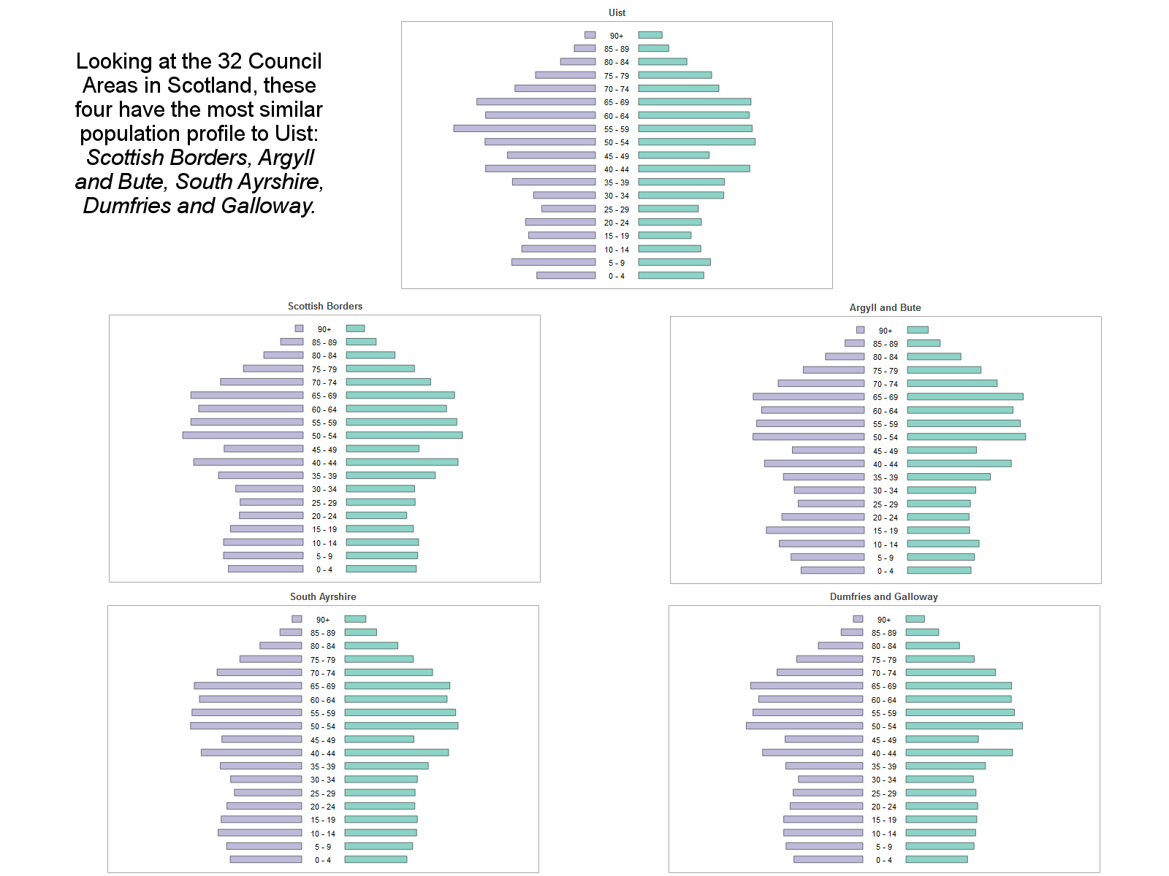

Slide 18
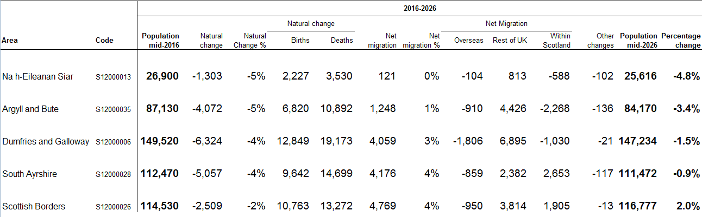
Comparable areas: 2016-26
Notes:
Source: https://www.nrscotland.gov.uk/statistics-and-data/statistics/statistics-by-theme/population/population-projections/sub-national-population-projections/2016-based/list-of-tables

Slide 19
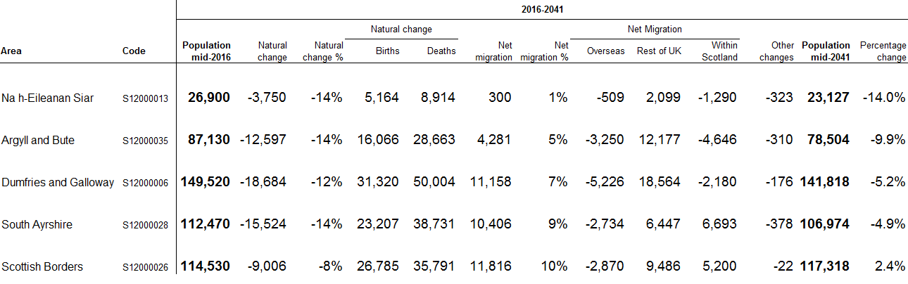
Comparable areas: 2016-41
Notes:
Source: https://www.nrscotland.gov.uk/statistics-and-data/statistics/statistics-by-theme/population/population-projections/sub-national-population-projections/2016-based/list-of-tables

Slide 20
Discussion of assumptions for comparable areas
Total Fertility Rate is assumed to increase steadlily for all areas: from 1.67 to 1.86 by 2041 for Western Isles.
Of the four areas only D&G has a lower TFR than Western Isles.
Local scaling for Western Isles assumes slightly higher fertility and mortality among males and slightly lower mortality among females compared to Scotland.
Notes:
Methodology: https://www.nrscotland.gov.uk/files//statistics/population-projections/sub-national-pp-16/pop-proj-principal-2016-tab-methodology.pdf
Local scaling factors are derived using expected for Scotland vs observed figures.
Live expectancy is also assumed to increase steadily.

Slide 21
Components of population change
Births
Deaths
Migration: internal and international
Notes:
Births and migration – largely discretionary components; scope for interventions is greater in developed countries.

Slide 22
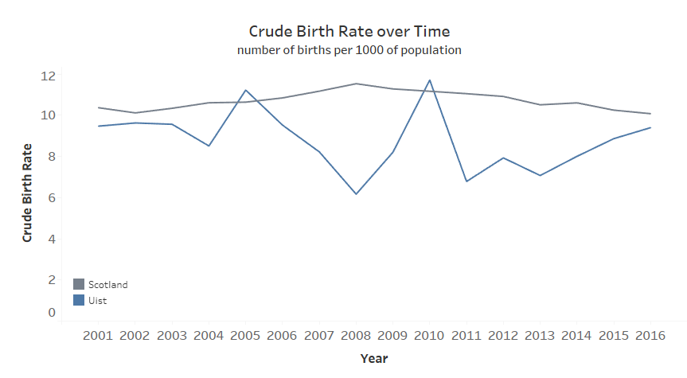
Births: unpredictable over long term
Notes:
Source: http://statistics.gov.scot/resource?uri=http%3A%2F%2Fstatistics.gov.scot%2Fdata%2Fbirths

Slide 23
More births-related discussion
Crude rate vs age-specific rate vs per 1000 of female population.
Area of active research into best ways to project fertility.
Notes:
Play interactive D3 from scotland census: http://www.scotlandscensus.gov.uk/NRSinteractivedata/fertility/fertility.html showing increasing average age of mother at childbirth – sadly mother’s age at childbirth by datazone (for Uist composite) not available
Interesting paper: https://www.humanfertility.org/Docs/Symposium/McDonald_Kippen.pdf

Slide 24
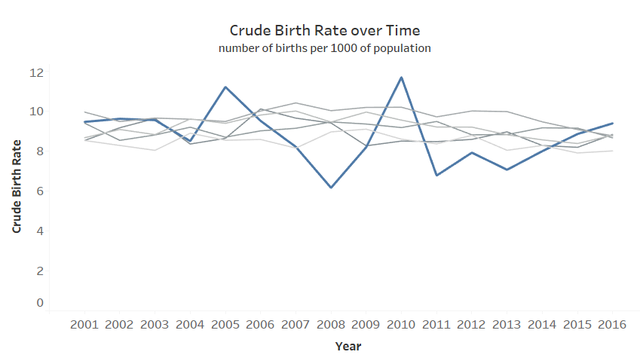
Naturally occurring variation vs special cause variation
Notes:
To illustrate the danger of small numbers projections or forecasting I plotted the five areas with comparable population structure to Uist. Naturally occurring variation is hard to separate from special cause variation.

Slide 25
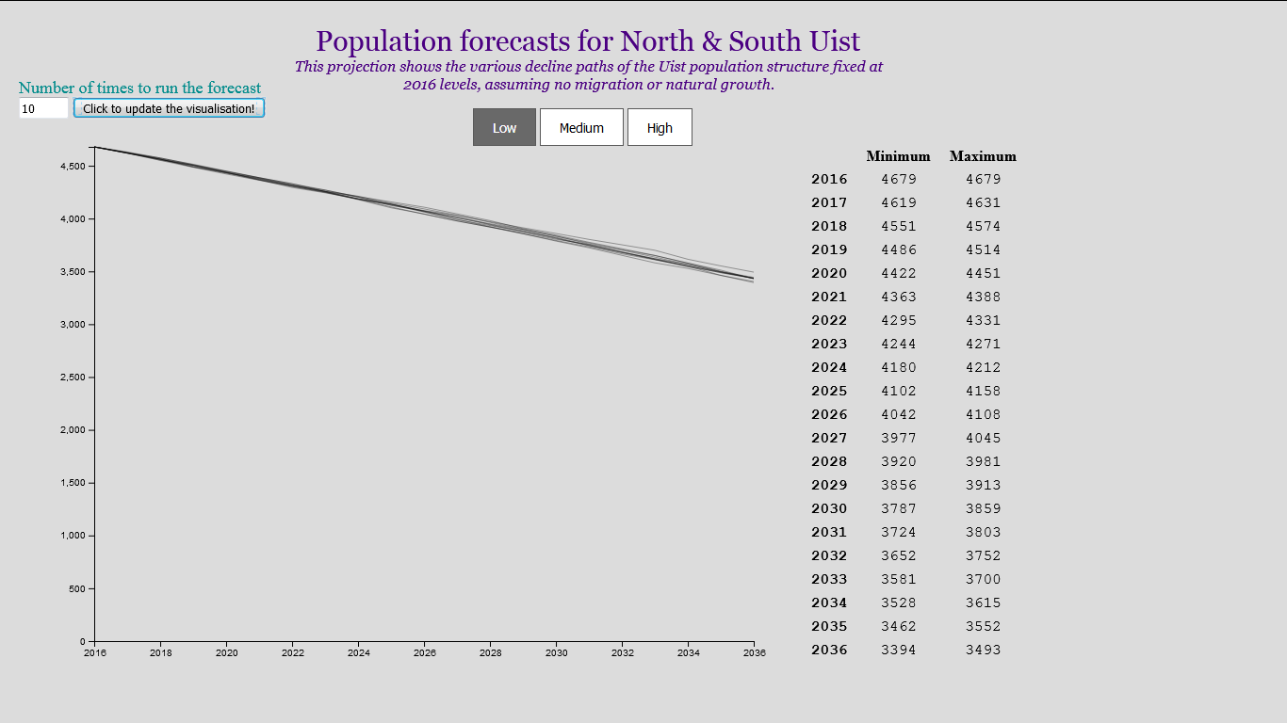
Deaths
Notes:
Demo D3 visualisation and discuss randomness. Deaths is probably the most predictable component as happens to all and doesn’t change that much compared to the other two components as both births and migration are “discretionary”.
Mortality assumptions are taken from the NRS document – show briefly.
Roughly 60 people needed to be replaced each year

Slide 26
Migration
“Over the last year, Scotland’s population has grown at a slower rate than on average over the past 10 years. This is because of reduced migration levels as well as an increase in the number of deaths and in the number of births. However, Scotland’s population is still projected to increase to 5.58m in 2026 and to continue rising to reach 5.69m in 2041.
We expect this growth to be entirely reliant on migration.
Amy Wilson, NRS director of statistical and registration services
August 2, 2018

Slide 27
Discussion of impact of migration on population forecasts
For every immigrant, there is an emigrant somewhere. Accounting for factors of both immigration and emigration is difficult which is why migration is the biggest single component of total error in projections.
Future net migration has been consistently underprojected since the 1970s.
Notes:
Migration assumptions have changed greatly, from assuming long-term net outward migration in the 1970s, to assuming net inward migration of 200,000 for the 2010-based projections, which is the highest long term net migration assumption made thus far. (UK-wide).

Slide 28
Migration methodology in NRS projections
No direct source of measuring migration
Internal migration based on movement of NHS patients: The NHS Central Register & CHI.
International component of migration is based on International Passenger Survey.
Despite some limitations, methodology is robust and best available at present.
Notes:
Research indicates that health service-based data tend to overestimate the size of the resident population in comparison to NRS usual population statistics. Also, young men are less likely to register with a GP and young people in general are less likely to tell their GP that they have moved.
The IPS conducts between 700,000 and 800,000 interviews a year, of which over 250,000 are used to produce estimates of overseas travel and tourism.
Sources: https://www.nrscotland.gov.uk/files/statistics/about/information-about-quality-assurance-arrangements-for-administrative-data-final.pdf
https://www.ons.gov.uk/surveys/informationforhouseholdsandindividuals/householdandindividualsurveys/internationalpassengersurveyips

Slide 29
Summary points
Forecasting works best when it’s more of the same (rate of change); direction of change much harder to predict without qualitative assumptions.
Sustainable population is about more than numbers: population structure matters in the long term.
Not alone in this position.

Slide 30
Questions?

Slide 31




Thank you!
Free or Opensource tools used in the analysis:

